Slide 1
Maths
Unit 6 – Fractions and Percentages.
WALT:
6Nf.07: Recognise percentages of shapes and whole numbers.

Slide 2
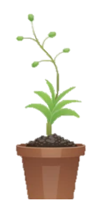
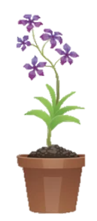
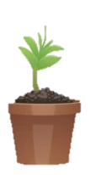
WALT: Recognise percentages of shapes and whole numbers.
With support, I can find percentages of amounts.
Independently, I can find percentages of amounts.
I can create my own percentage bingo card.

Slide 3
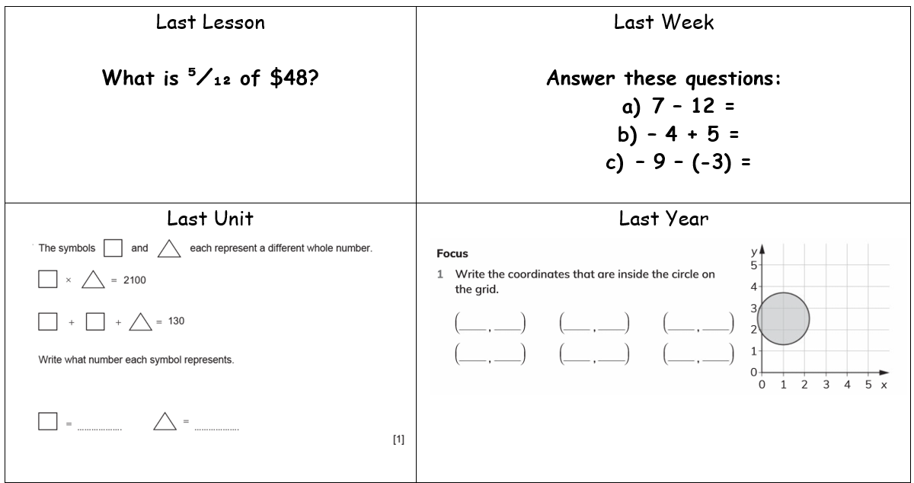
Retrieval Practice
WALT: Recognise percentages of shapes and whole numbers.

Slide 4
Starter – Discuss with your partner
WALT: Recognise percentages of shapes and whole numbers.
How do we find 10% of a number?
How do we find 20%?
How do we find 1%

Slide 5
What is percentage?
WALT: Recognise percentages of shapes and whole numbers.
Percent means out of 100.
When we talk about percent, we mean “how many parts out of 100?”

Slide 6
Just like fractions we can use percentages as operators.
WALT: Recognise percentages of shapes and whole numbers.
How could we find 40% of 600?
To find 10% we divide 600 by 10. 60
240
To find 40% we multiply 60 by 4. 240

Slide 7
Just like fractions we can use percentages as operators.
WALT: Recognise percentages of shapes and whole numbers.
How could we find 4% of 600?
To find 1% we divide 600 by 100. 6
24
To find 4% we multiply 6 by 4. 24

Slide 8
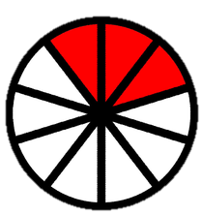
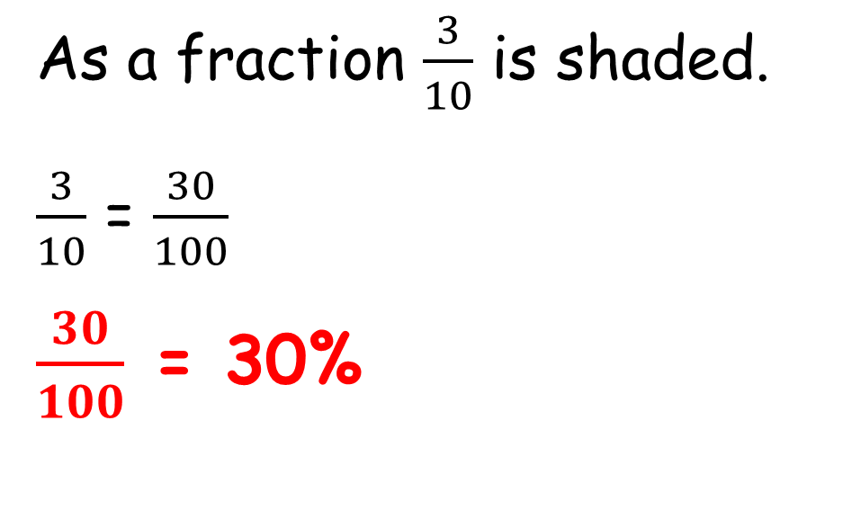
We can also calculate the percentages of shapes.
WALT: Recognise percentages of shapes and whole numbers.
What percentage of this shape is shaded?
As a fraction $\frac{3}{10}$ is shaded.
$\frac{3}{10}$ = $\frac{30}{100}$
$\frac{30}{100}$ = 30%

Slide 9
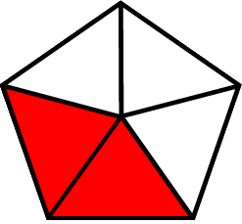
Check your understanding
WALT: Recognise percentages of shapes and whole numbers.
What is 70% of 350?
2. What percentage of this shape is shaded?

Slide 10
Check your understanding
WALT: Recognise percentages of shapes and whole numbers.
What is 70% of 350?
2. What percentage of this shape is shaded?
245
40%

Slide 11
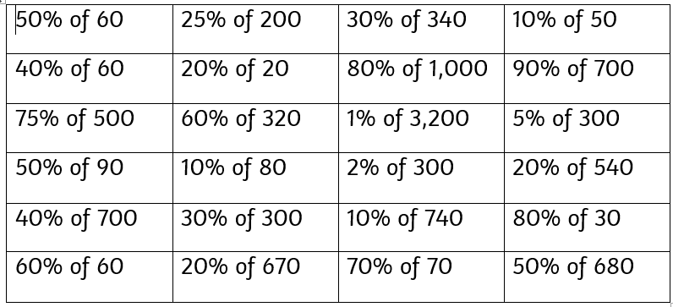
Percentage Bingo
WALT: Recognise percentages of shapes and whole numbers.
Choose 9 of these percentage amounts and write them in the 3 X 3 grid.

Slide 12
Percentage Bingo
WALT: Recognise percentages of shapes and whole numbers.
I’m going to read the answers. You need to cross off the question that gives that answer if you have it.
If you get a row or column shout “Bingo!”.
If you get all 9 squares shout “Full House!”

Slide 13
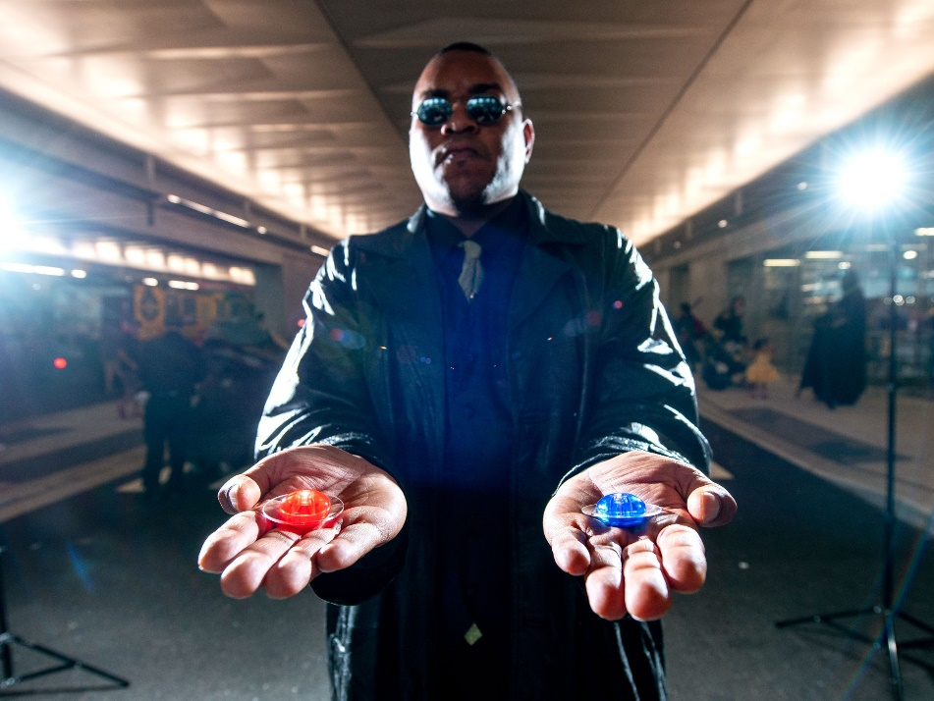
Now you have a choice
WALT: Recognise percentages of shapes and whole numbers.
Play bingo again with me
Create your own bingo game with questions and answers.

Slide 14
WALT: Recognise percentages of shapes and whole numbers.
With support, I can find percentages of amounts.
Independently, I can find percentages of amounts.
I can create my own percentage bingo card.

Slide 15
Plenary – Ms. Alice says “To find 34% of 600 I should divide 600 by 34.” Is she correct? Explain your answer.
WALT: Recognise percentages of shapes and whole numbers.

